Slide 1
Internet Programming
#03- JavaScript in the Browser
Wekoslav Stefanovski

Slide 2
Agenda
Connecting HTML and JavaScript
Inline JavaScript
External JavaScript Files
Asynchronous and Deferred Loading
Inspecting JavaScript in the Browser

Slide 3
Connecting HTML and JavaScript
JavaScript in the browser does nothing by itself
We can write it directly into HTML files
We can load it externally
Synchronously
Asynchronously

Slide 4

Inline JavaScript
Uses a <script> tag with no attributes
Same file as the HTML
Executes immediately at the place where it’s defined
Useful for experimenting

Slide 5
External JavaScript files
Uses a separate file, usually with a .js extension
Included inside the HTML with a <script> tag with a src attribute
Inclusion in body
Inclusion in head
We can control execution strategies

Slide 6
Asynchronous and Deferred Loading
We can add the async attribute to the script tag
We can add the defer attribute to the script tag
If we add them both, it’s implementation specific

Slide 7
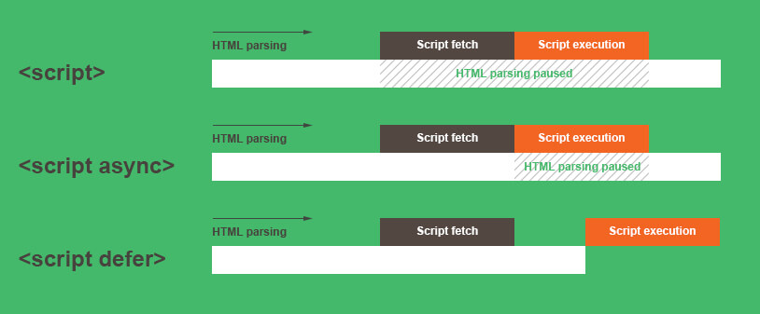
Asynchronous and Deferred Loading

Slide 8
Inspecting JavaScript in the Browser
Developer tools
Inspecting elements
Using the console to interact with existing code
Viewing and debugging source code

Slide 9
References
Twitter Handle - @swekster
Discord Server - https://discord.gg/uWZ3RJfBQ5
Email - swekster@gmail.com
Github - https://github.com/sweko/uacs-internet-programming-2024
Youtube - https://www.youtube.com/@swekster

